Slide 1

Building Successful Low Budget PPC
In charge of building your first PPC account?
Don't have a lot of time or money to spend within AdWords? Well, you came to the right place!

Slide 2

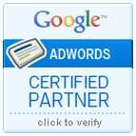
GETTING STARTED
2
Through this slide show, pick up beginner tips on:
Account Structure
Campaign Settings
Keyword Lists
Ad Text & Format
Ad Extensions
Tracking Success

Slide 3
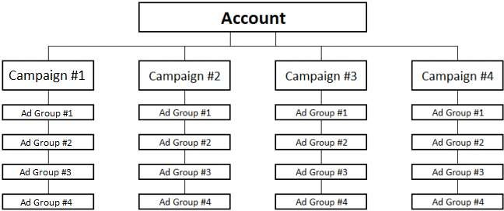
STRUCTURING YOUR ACCOUNT
3
Understanding how to setup the structure of your account is vital to PPC success.
Determine your campaigns
Shape ad groups inside each campaign
Map out your structure before anything else

Slide 4
UNDERSTANDING YOUR CAMPAIGN SETTINGS
4
Selecting the ideal campaign settings for your needs can make or break account success.
Do you want to show your ads on the Search or Display Network?
Pro-tip: Do not target the Search and Display Networks within the same campaign. Separate campaigns by Network type.
Set your device targeting
Pro-tip: Understand how device type effects conversion rate on your site.
Location targeting
Target your customer base by country, state, city, congressional district or DMA region.
Bidding and budget
Set a daily budget you are comfortable with and manually set your keyword bids.

Slide 5
SELECT YOUR KEYWORDS
5
Building a descriptive keyword list that closely represents your product or service line will give life to your account, put your ads in front of a relevant audience, and reduce wasteful spend.
Build out a list of keywords that align with your campaign and ad group structure
Use the AdWords Keyword Tool to get new ideas.
Select appropriate match types
Broad, phrase, or exact match? The more specific the better.
Implementing negative keywords is a good way to exclude irrelevant search impressions

Slide 6
CRAFT ADS THAT WILL DRIVE ENGAGEMENT
6
Ads need to be informative, eye catching, and relevant to what a customer is searching for. Ads that are bland are easily overlooked, while ads with irrelevant ad copy can result in wasteful clicks from unqualified customers.
Understand ad structure
Headlines, description lines, display URL and destination URL.
Learn text ad specifications
Do your homework
Make sure your ads make sense!
Use proper punctuation and title case.
Your ads need to stand out
Don't be afraid to be edgy, playful, direct, ect. based on your brand
personality and industry.

Slide 7
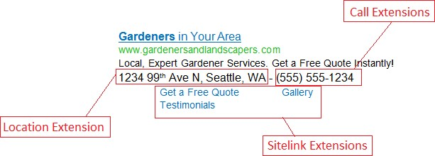
UTILIZE ACCOUNT EXTRAS LIKE AD EXTENSIONS
7
Each extension offers a unique way for you to provide potential customers with additional information such as phone numbers, directions, or services about your business.
Sitelink Extensions
Link customers to deeply targeted pages.
Call Extensions
Place your phone number front and center.
Location Extensions
List your business address directly in the search results.

Slide 8
TRACK YOUR SUCCESS
8
The ability to enable tracking features for key performance indicators such as transactions completed or leads generated is essential for not only managing your ads after activation, but tracking the success of your paid search effort.
AdWords conversion tracking
Set up conversions for transactions completed or submission forms received.
Link AdWords and Google Analytics
Gain access to advanced analytics data to learn how PPC traffic is engaging on your site.

